Slide 1

Business Operations
Module - 4

Slide 2

Welcome!!

Slide 3
Key positions and human capital needs
What is the Difference between Copyright, Patent and Trademark?
Outlines
Intellectual Property in Egypt
Manage and Operate Business
Corporate Social Responsibility for Startups
Responsibility to the Environment
Business Sustainability
Why R&D is important for small business
Assessment
Activity

Slide 4

Key positions and
Human Capital Needs

Slide 5
Why startups need some HR functions
Startup and SMBs rely on a flexible business culture. They need to be able to fail fast and pivot. Structured HR and recruiting practices aren’t the first things they prioritize because executives see them as dreadful “corporate,” culture-killers that threaten innovation and flexibility. So, developing good HR and recruiting processes usually takes a backseat.
Businesses that deliberately develop a strong HR function show that they value employees and their business. These companies are better at:
Hiring employees
Developing employees
Retaining employees

Slide 6
HR Processes help startups and SMBs Hire Employees

Slide 7
Create inclusive job titles and descriptions that aren’t discriminatory. HR staff help you come up with accurate job titles and job descriptions to entice qualified candidates to apply. This is key for startups looking to scale and hire diverse teams.
Conduct structured job interviews. Hiring the right people is critical for small businesses, and unstructured interviews invite bias into hiring processes. HR and recruiting staff can help startups follow structured interview processes to rate candidates on fair, predetermined criteria.
Protect businesses from lawsuits. HR staff are the point-people for legal matters – including state and federal labor laws. HR staff help you understand complex legislation and what it means for your business.

Slide 8
HR processes help startups and SMBs develop and retain employees
Fairly compensate workers. Compensation and benefits are a huge part of HR. Without HR professionals, conversations about pay increases are fraught and could come down to how managers ‘feel’ about an employee or position instead of what the fair market value for a role is.
Invest in training managers. Startups are full of people who are “generalists” – employees who wear a lot of hats. These generalists often find themselves in management roles, without any formal management experience.
Care about workplace culture. Good HR and recruiting departments take the pulse of employees in a way that doesn’t feel like policing. They consider their candidate experience, conduct new hire check-ins and meet with employees regularly.
Recognize the need for policies. As businesses grow, new employees may encounter new workplace issues: e.g. how to manage noise, process expenses and manage paid time off. HR departments work with executives to create policies that answer those questions uniformly.
Cultivate career paths. When companies reach at least 30 employees, figuring out how to develop those employees becomes critical to retaining them

Slide 9
what you don’t need to build and run a successful HR department:
Jargon. Jargon alienates employees, fosters distrust and diminishes productivity. HR departments should strive to communicate clearly, concisely and in-person, whenever possible.
Going “by the book” in every case. Startups don’t need to have hard and fast rules that govern every aspect of office life (e.g. formal dress codes are out of fashion.)
A defined set of ‘corporate values.’ At the corporate level, you might need these – as there are usually many divisions, employees and cultures at bigger companies.
An employee handbook. You need some policies (e.g. sick time, paid time off) but as a startup, you probably don’t need something as exhaustive as an employee handbook.

Slide 10

what you do need to do to develop an innovative HR department:

Slide 11
1. Hire the right HR staff. These employees will be the ambassadors of your company culture, so look for individuals who embody it. Consider hiring people who can serve as both:
HR coordinators: This person meets with employees on an informal regular basis and encourages managers and employees to resolve issues amongst themselves.
Recruiters: This person should meet with managers regularly to gain a sense of what qualities they value in candidates. They should also be able to identify each department’s hiring needs, build talent pipelines and create good candidate experiences.

Slide 12
2. Encourage proactive HR involvement. Proactive HR staff do the legwork to meet people face-to-face and learn what drives employee engagement. This fosters trust in HR, instead of fear. Proactive HR employees:
Conduct regular check-ins with employees
Meet with passive candidates
Welcome new hires with flair

Slide 13
3. Empower your HR staff. An empowered HR staff is a group that doesn’t have to run back and forth between executives and employees to gain approval for everything they say. They are free to represent employees and share information with them. Their employee goals might include:
Onboarding employees correctly
Measuring employee engagement
Communicating with employees about what’s going on at the company
Being competitive with compensation and benefits
Actively cultivating the culture of the office

Slide 14
4. Invest in good HR software. There’s a lot of HR software to choose from, and much of it can streamline some aspects of HR (e.g. applicant tracking systems, HRIS and sourcing tools.) Keep in mind, though, that even the best HR software isn’t enough to replace human staff.

Slide 15

Startups Should
Consider Outsourcing

Slide 16
In the competitive world of startups, founders should focus on core business operations without distractions. But at the initial stages of business expansion, funds, and staff are limited. It’s the problem that drives most startup owners to wear too many hats and try to do it all as a way of saving money and time.
As a startup founder, you must be careful. Taking on too many tasks can sacrifice quality and accuracy. Alternatively, when entrepreneurs outsource, they’re connecting their startup with expert teams that have the knowledge and skill sets for handling a variety of tasks while avoiding errors.

Slide 17
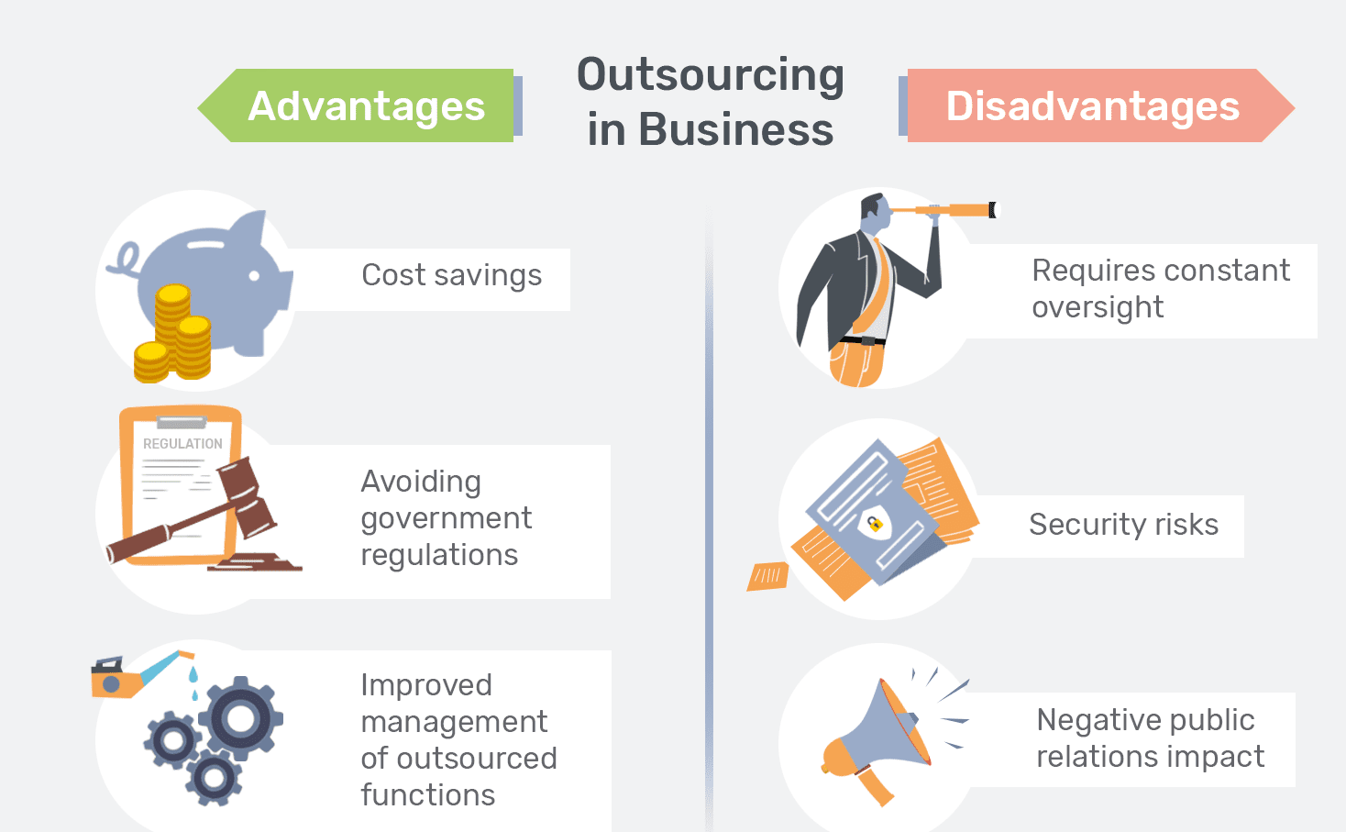

Slide 18

If you’re looking for specific suggestions, three tasks that are always beneficial to outsource are:
Administrative duties
IT services
Payroll
What should
startups outsource?

Slide 19
Administrative Duties
Outsourcing administrative duties passes the responsibilities of taking notes and answering emails to outsourced workers. Important scheduling matters such as employee work hours and meetings can also be outsourced, which is especially beneficial when there’s no HR department.
As you and your staff work on more pressing projects, you can be confident that your outsourced assistants aren’t missing a beat when it comes to keeping your company organized while promptly communicating with clientele, potential business partners, and investors.

Slide 20
IT Services
Outsourcing to tech providers is one of the more obvious routes to keep your company competitive. You can work with a larger talent pool than in house and the team will already have whatever specialized equipment they need. Indeed, what makes IT outsourcing providers stand out is their emphasis on cutting-edge technology that will support the deployment of the highest quality products.

Slide 21
Payroll
Consider the fact that small businesses have paid billions in fines annually due to incorrect payroll information. Outsourcing payroll protects you and your staff because it provides the accuracy needed to prevent legal punishments and pay your team accordingly.
Bottomline, startups owners must be driven to succeed while utilizing cost-effective solutions to build their business and reach consumers in competitive markets. To ensure that your business is functional while avoiding critical errors that can damage your brand’s reputation, outsourcing is the way to go.

Slide 22
Difference between Copyright, Patent and Trademark?

Slide 23
A copyright is a collection of rights automatically vested to you once you have created an original work. To understand how these rights can be used or licensed, it is helpful to analogize them to a bundle of sticks, where each stick represents a separate right vested to you as the owner. These rights include the right to reproduce the work, to prepare derivative works, to distribute copies, to perform the work publicly, and to display the work publicly.
As the copyright owner, you have the authority to keep each “stick,” to transfer them individually to one or more people, or to transfer them collectively to one or more people.

Slide 24
The primary goal of the patent law is to encourage innovation and commercialization of technological advances. Patent law incentivizes inventors to publicly disclose their inventions in exchange for certain exclusive rights. A patent protects inventions. These inventions can include new and useful processes, machines, manufactures, compositions of matter as well as improvements to these. Certain computer programs may fall within the subject matter protected by both patents and copyrights. In this respect the patent system compliments copyright protection by providing protection for functional aspects of the software, which are not protected by copyright.

Slide 25
A trademark is a word, phrase, symbol, and/or design that identifies and distinguishes the source of the goods of one party from those of others. A service mark is a word, phrase, symbol, and/or design that identifies and distinguishes the source of a service rather than goods. Examples include brand names, slogans, and logos.

Slide 26
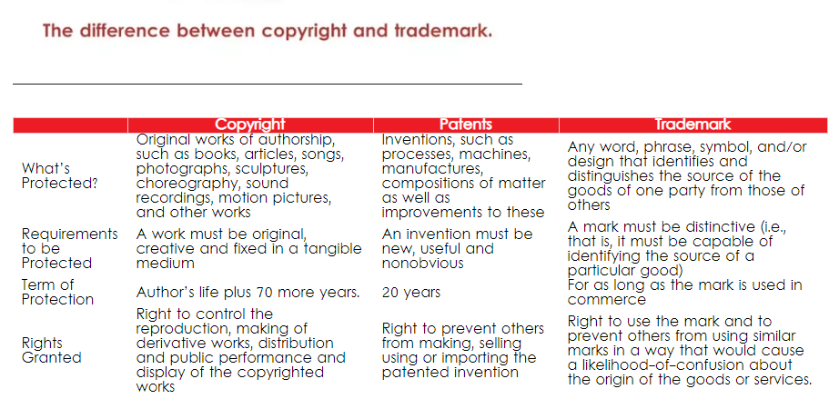

Slide 27

Intellectual Property in Egypt

Slide 28
The Copyright Law, No. 354 of 1954, provides copyright protection for, inter alia, written works, paintings, sculpture and architecture, theater and musical pieces, photographs and cinematographic films, television and radio works for publication, maps, and speeches. A 1992 amendment to the Copyright Law stiffened the penalties available under the Copyright Law and also provides for protection of video tapes.
A 1994 amendment to the Copyright Law treats computer software as a literary work and guarantees it a fifty year term of protection. Protection under the Copyright Law terminates fifty years following the demise of the author. Should the copyrighted material be owned by a legal entity rather than a natural person, then the fifty year protection period begins on the date the material was first published. The author may assign the rights granted to him by the law to other persons, subject to certain limitations set by the law.

Slide 29
The law on Patents and Industrial Designs, Law No. 132, of 1949, as amended, grants inventors fifteen years of patent protection from the date of application. In some cases, it may be extended for an additional five year term. The patent holder has exclusive rights to the invention and may license, assign, pledge or in any other way act with regard to the patent. At the end of the patent protection period, the invention enters the public domain.
Egypt has adopted the Paris Convention, and, accordingly, a patent application filed in a member country entitles the applicants to apply for a patent in Egypt within one year.

Slide 30
The Trademarks Law, No. 47 of 1939, as amended, grants a ten year protection period to trademark holders from the date of application. The trademark is renewable for similar periods without restriction; an application must be filed for each renewal period.

Slide 31
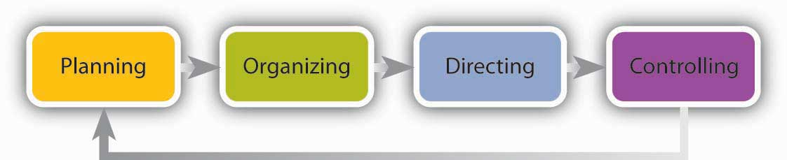
Manage and Operate Business

Slide 32

DEFINING MANAGEMENT
Management is a process with a social element. It requires the efficient use of resources combined with the guidance of people in order to reach a specific organizational objective. It involves responsibility to achieve the objectives and to fulfill specific organizational purposes through economical and effective planning and regulation. It’s about taking charge and ensuring focus is placed on the things and aspects of the business that help achieve the vision and the goals.

Slide 33

FUNCTIONS OF
MANAGEMENT
While there are slight variations in how the functions are named and the different management theories might combine or divide certain functions into smaller chunks, the consensus points to four core functions. What do these functions entail, why are they important and how to utilize them?

Slide 34
Planning
The first managerial function involves planning. The function is about creating a detailed plan towards achieving a specific organizational objective. When you are planning, you are identifying the tasks, which are required to achieve the desired goals, outlining how the tasks should be performed, and identifying when and by whom they must be performed.

Slide 35
Why is planning essential?
Why is planning important? Planning provides the organization a better sense of what it wants to achieve and how it can achieve this. You essentially have more focus when you plan for things. Think what would happen if you went into a big job interview without any planning.
A key part of planning is also the vital role it plays in reducing risks. When management plans for the tasks ahead, they are looking at the situation and detailing the possible pitfalls ahead. As with your interview, the risk of not knowing anything about the company or giving an incoherent answer is higher than if you had planned your answers a little.

Slide 36
How to plan?
When you need to come engage in planning, you should focus on the following steps:
Gain knowledge of the issues – You need to understand the organizational objectives, the different components they involve, and the available resources you and the team have.
Look into the future – The function is about understanding the short- and long-term objectives the organization wants to achieve. You need to consider not just these different elements, but also be able to make predictions about the future conditions for achieving these
Determine the objectives – Once you are aware of the organizational objective, the resources available, and the future outlook to achieving the objectives, you need to identify the specific processes and detailed goals that are required to achieve the bigger goal.
Create flexible structures – However, your planning needs to be flexible and take into account things don’t always go according to plan. Your management plan must take into account the other departments and their specific organizational goals

Slide 37
Organizing
Organizing is the function of management which follows planning. It is the process of establishing orderly uses for all resources within the management system of the organization. It is a function in which the synchronization and combination of human, physical, financial, and information resources takes place for the achievement of the results.

Slide 38
Organizing
Organizing is the function of management which follows planning. It is the process of establishing orderly uses for all resources within the management system of the organization. It is a function in which the synchronization and combination of human, physical, financial, and information resources takes place for the achievement of the results.
Organizing refers to the following process.
Identifying and grouping of the work to be performed.
Defining and determining responsibility and authority for each job position.
Establishing relationship among various job positions.
Determining detailed rules and regulations of working for individuals and groups in organization.

Slide 39
Importance of organizing
Organizing function follows the planning function. Plans prepared under the function of planning govern all aspects of organizing function. Since the organizing follows planning it is closely related to it. The organizing begins after the plans are prepared and is governed by the prepared plans. While the plans state where the organization is to go, organizing helps the organization how to get there.
Organizing function shows the management how the organization is to be built or how the existing one is modified to ensure that the goals set in the plans are achieved.

Slide 40
Process of organizing
Organizing, like planning, is a process which is to be carefully worked out and applied. This process involves determining what work is needed, assigning those tasks, and arranging them in a decision-making framework (organizational structure). If this process is not conducted well, the results may be confusion, frustration, loss of efficiency, and limited effectiveness. The process of organising consists of the following five steps.

Slide 41
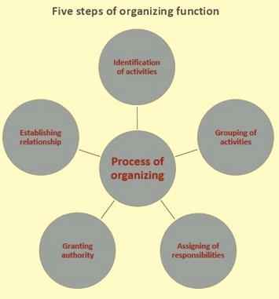
Identification of activities
Grouping of activities
Assignment of responsibilities
Granting authority
Establishing relationship

Slide 42
Organizing principles
Organizing function is effective only if the management follows some guiding principles in order to make important decisions and act upon them. For an efficient organizing function the following are the guiding principles.
Principle of specialization
Principle of functional definition
Principles of supervision or span of control
Principle of scalar chain
Principle of unity of command

Slide 43
Benefits of organizing
The end result of the organizing process is an organization which is whole consisting of unified parts (a system) acting in harmony to execute tasks to achieve goals, both effectively and efficiently.
A properly implemented organizing process results in a clarified work environment. Everyone in the organization knows what to do..
There is an environment of coordination and cooperation in the organization. The interrelationships of the various work units gets developed
A formal decision-making structure gets established in the organization.

Slide 44

Directing
Directing can be defined as that function of management, which helps in guiding and leading people to work in such a manner so as to perform efficiently and effectively for the attainment of organizational objectives. Directing is the managerial function, which initiates organized action.

Slide 45
There are various elements involved in direction are as follows
Issuing Orders and Instructions to Subordinates
An order should serve the following characteristics:
The order should be clear and complete.
It should be reasonable and attainable.
The order must be in tune with the various other objectives of the organization and also for the interests of the subordinates.
All order should follow the chain of command.
Face-to-face suggestions are preferable to long­ distance orders.

Slide 46
There are various elements involved in direction are as follows
Supervision in an overall manner
It refers to monitor the progress of routine work of one’s subordinates and guiding them properly. Supervision is an important element of the directing function of management.
Supervision has an important feature which includes face-to-face interaction between the supervisor and his subordinates.
It involves direct personal contact with subordinates. Supervision converts plans into action. Thus supervision is considered as an essential step in the process of directing.

Slide 47
There are various elements involved in direction are as follows
Motivating Subordinates
The term motivation can be referred to as that process which excites people to work for the attainment of the desired objective. Among the various factors of production, it is only the human factor which is dynamic and provides mobility to other physical resources.
Thus, in an overall sense, it becomes essential so as to motivate the human resources so as to keep the employees dynamic, aware and eager to perform their duty. Both the monetary and non-monetary incentives are given to the employees for motivation. Thus through motivation, the employees will perform better. Hence, it will help to achieve the organizational goals and objectives.

Slide 48
There are various elements involved in direction are as follows
Providing Leadership
The term Leadership defines as to influence others in such a manner as to guide them to do what the leader wants them to do. Leadership plays an important role in directing. Only through this leadership skill, a manager can develop trust and zeal among his subordinates. Therefore it leads to guide and provide overall counselling to subordinates in the best way for achieving their objectives and also for the organization.

Slide 49
There are various elements involved in direction are as follows
Communicating with Subordinates
It refers to an act of transferring facts, ideas, feeling, etc. from one person to another and making him understand them. A manager has to continuously t guides and also at the same time, monitors his subordinates about what to do, how to do, and when to do various things.
Also, it is very essential to know their reactions. To do all this it becomes essential to develop effective telecommunication facilities. Therefore, the essential feature is to communicate with itself can be called by developing mutual understanding inculcates a sense of cooperation which builds an environment of coordination in the organization.

Slide 50
There are various elements involved in direction are as follows
Maintaining discipline and Rewarding Effective People
By maintaining an atmosphere of discipline and trust in the organization, the manager can easily give directions. So that the work done by his employees is in most efficient and effective manner.
In return, the employees will get a reward in the form of bonus, incentives and other perks so as to get themselves associated with the organization on a long-term basis. Therefore, this element of direction also plays a very important role in achieving overall objectives of an organization.

Slide 51
Controlling
The final function of management is controlling. The function ensures the other thrree functions are followed correctly and the flow of work is moving the organization towards the objectives it has set itself.
Controlling is
“the process of checking whether or not proper progress is being made towards the objectives and goals and acting if necessary, to correct any deviation“.

Slide 52

Why is controlling essential?
Controlling’s most important function is the risk-reduction ability. Since you are essentially monitoring the performance of the team and comparing it against the objectives you’ve set, you can react to problems more easily. Instead of realizing at the end of the month that you’ve missed your sales target by a huge margin, you can keep on eye on the situation during the process.

Slide 53
How to control?
Establish standards of performance
Measure the actual performance
Compare the actual performance with the expected standards
Take corrective action

Slide 54
Corporate Social
Responsibility for Startups

Slide 55
As we move further into the 21st century and become more aware of how our actions affect our environment and societies, a lot of words keep popping up that were not even in our vocabulary a few decades ago. Things like sustainability, having a green building, reducing our carbon footprint, and of course, Corporate Social Responsibility (CSR), are all things that companies around the world are doing their best to achieve.
Defining CSR is almost impossible to do in one simple sentence since there are many activities that contribute to this movement, including:
Protecting the environment and having a sustainable work environment
Working with local charities and communities to improve the lives of others
Creating fulfilling relationships with both customers and employees and providing a safe and supportive work environment
Socially responsible investment – i.e. green or ethical investing

Slide 56
Why is CSR important for startups?
Not only do CSR initiatives benefit society in more ways than one, it can also be a beneficial factor in terms of your overall marketing strategy. Being known as a startup that is sustainable and contributes to society gives you greater brand perception and helps build loyalty and trust.
Initiating and maintaining CSR in your startup will give you more transparency as a business and give you an edge over competitors.

Slide 57

How can startups do their part?

Slide 58
SUPPORT EQUALITY
Providing a safe and supportive environment is one of the key activities of corporate social responsibility, so ensuring that your business is fair to everyone regardless of age, sex, or race is crucial.
CONNECT WITH THE COMMUNITY
There are several ways that you can help:
Take part in volunteering days – even if it’s once a month.
Hold a fundraising event to raise money – this can be great PR for both you and the organization.
Dedicate a percentage of your profits that go directly toward the charity every month.

Slide 59
BUILD ETHICAL NETWORKS
With the strain our natural resources and environment are under in order to meet the needs of manufacturing for a growing population, it’s important to your CSR to only work with ethical suppliers who are environmentally sustainable. This means aligning yourself with partners and other businesses who share the same corporate social responsibility views so you can honestly share where your products are coming from with the public. You don’t want to get down the line and realize that you are losing customers, all because the items used to make your products are sourced unethically.

Slide 60
USE A SUSTAINABLE WORKSPACE
Having a sustainable workspace for your startup goes beyond adding a few plants to make a green office, you need to think about the overall environmental impact. Also, how the office is designed can be a big factor in the overall health and productivity of your staff.
Rather than renting out an office space that could be a waste of valuable resources, a coworking space like Garage Society is a great solution. Not only are the workspaces set up in a sustainable way, they also promote creativity and collaboration.

Slide 61
USE A SUSTAINABLE WORKSPACE
Having a sustainable workspace for your startup goes beyond adding a few plants to make a green office, you need to think about the overall environmental impact. Also, how the office is designed can be a big factor in the overall health and productivity of your staff.
Rather than renting out an office space that could be a waste of valuable resources, a coworking space like Garage Society is a great solution. Not only are the workspaces set up in a sustainable way, they also promote creativity and collaboration.

Slide 62
Responsibility to the Environment

Slide 63
Sustainable Design. Traditionally, products were made and used without much thought for their long-term impact on people or the planet. In contrast, design that is sustainable meets the planet’s current needs while preserving resources for future generations.
Alternative Energy. Researchers are working to make alternatives to oil and coal—such as solar, wind, and hydrogen power—more efficient. They’re testing newer forms of biofuels extracted from corn, sugar cane, and even vegetable oil left over from frying foods
Organics. Concerns about personal health, as well as the environment, have increased interest in organic products, those made from crops and animals that are raised without manufactured chemicals. Organic produce, grains, and meats make up a small but steadily growing segment of the food market
Fair Trade. As you learned in Chapter 2, fair trade is a way of doing business that is based on principles of social and environmental responsibility and promoting sustainable growth. Most producers involved in fair trade are small farmers and skilled crafters in developing countries. These micro entrepreneurs form cooperatives to set prices and product standards

Slide 64
The Energy-
Efficient Workplace

Slide 65
Here are five ways that a business can lower its expenses, while also helping the environment:
- Get into the recycling loop. First, recycle everything your community has facilities for. Most localities have paper and plastic recycling programs. Your community also might have businesses that recondition older computers and other office equipment.
- Do business electronically. Reduce paper as much as possible. Take advantage of vendors’ toll-free telephone numbers and Websites to place orders. If you send out newsletters to regular customers, encourage them to take an e-mail version instead of paper.
- Buy supplies in bulk. Items sold in large quantities usually cost less per piece and may use less packaging.
- Replace incandescent light bulbs with fluorescent ones. Compact fluorescent light bulbs have a longer life and greater efficiency and will save money in the long run.
- Use environmentally friendly transportation. You might adjust schedules or business hours to take advantage of carpooling or public transportation. Offer employees low-cost incentives, such as a gift card from a bicycle shop for those who ride to work.

Slide 66

Business
Sustainability

Slide 67
Develop a Small Business Sustainability Plan
If you’re a small business owner, you may be wondering what you’ll gain by adopting a small business sustainability plan. In a word, plenty! Regardless of your industry, adopting sustainable business practices can improve your bottom line—in both the traditional and the environmental sense.

Slide 68
What Is a Business Sustainability Plan?
A business sustainability plan is simply something an organization develops to achieve goals that create financial, societal and environmental sustainability. A business impacts communities and resources, so taking these steps to sustainability is in the best interests of the environment, the business owner and the consumer.

Slide 69
Reasons to Build a Sustainable Business
Making the case for a sustainable business is simple: an environmentally friendly business can be a profitable one. You can decrease your business’s negative impact on the

Slide 70

Planning for
Business Growth
To grow a business means to make changes that result in greater sales. A business grows, or expands, in two ways: internally and externally. Organic growth is growth achieved by expanding a business internally—for example, adding new products or services for sale. External growth is achieved by buying other businesses or merging with them. Most small businesses experience organic growth rather than acquiring other companies.

Slide 71
What Is Business
Growth?
To grow a business means to make changes that result in greater sales. A business grows, or expands, in two ways: internally and externally. Organic growth is growth achieved by expanding a business internally—for example, adding new products or services for sale. External growth is achieved by buying other businesses or merging with them. Most small businesses experience organic growth rather than acquiring other companies.

Slide 72
Three factors affect the decision to grow a business:
- Condition of the Business. A business is ready to grow when it has a solid base of customers and makes sales that meet or exceed forecasts and contribute to a satisfactory net profit.
- Economic Climate. The economic climate in which the business operates is also important. Owners planning for growth must consider economic conditions at the local, national, and perhaps even global levels.
- Life Goals of the Business Owner. Growing a business is not only an economic move, it’s a personal one as well. An owner who decides to grow a business takes on new pressures and demands.
Deciding
When to Grow

Slide 73
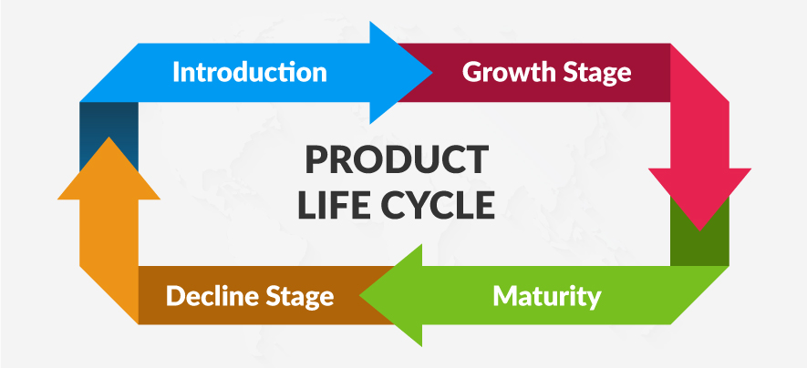
Product Life Cycles

Slide 74
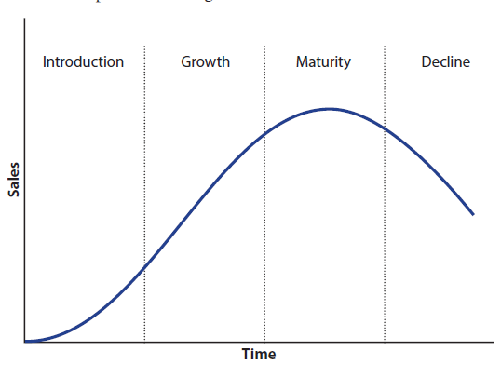
Product Life Cycles

Slide 75
Product Life Cycles
- Introduction. When a product is introduced, the marketing effort is devoted to building product awareness—that is, making consumers aware of the product.
- Growth. Sales and profit increase steadily as the product is embraced by consumers.
- Maturity. This is the stage during which sales and profits stop growing. They level off and may begin to decline.
- Decline. During the decline stage, product sales and profits fall steeply and don’t recover. The product loses its appeal to consumers. In some cases, the decline is due to technological advances or governmental regulations.

Slide 76
Growth Strategies
Businesses can follow many growth strategies when they wish to expand. These strategies typically focus on new products and/or new markets. (In this discussion, services are referred to as the products of a service business.) Three broad categories of growth strategies are:
Intensive growth strategies
Integrative growth strategies
Diversification growth strategies

Slide 77
Intensive Growth Strategies
An intensive growth strategy is a growth strategy that focuses on cultivating new products or new markets, and sometimes both. Businesses use an intensive growth strategy when they believe they haven’t fully realized their strengths or their markets. This strategy is best described as “doing more of what you are good at doing.” The three most common types of intensive growth strategies are:
Market penetration
Market development
Product development

Slide 78
Intensive Growth Strategies
An intensive growth strategy is a growth strategy that focuses on cultivating new products or new markets, and sometimes both. Businesses use an intensive growth strategy when they believe they haven’t fully realized their strengths or their markets. This strategy is best described as “doing more of what you are good at doing.” The three most common types of intensive growth strategies are:
Market penetration
Market development
Product development

Slide 79
Intensive Growth Strategies
An intensive growth strategy is a growth strategy that focuses on cultivating new products or new markets, and sometimes both. Businesses use an intensive growth strategy when they believe they haven’t fully realized their strengths or their markets. This strategy is best described as “doing more of what you are good at doing.” The three most common types of intensive growth strategies are:
Market penetration
Market development
Product development

Slide 80
Diversification Growth Strategies
Every business has a core business, which is the most important focus of the business. For example, the core business of McDonald’s is selling fast food. A diversification growth strategy (die-ver-sih-fih-KAY-shun) is a growth strategy in which a business grows by offering products or services that are different from its core business. There are two types of diversification growth strategies:
- Synergistic Diversification. A growth strategy in which a business adds new products or services that are related to its existing products or services is a synergistic diversification (sin-er-JIS-tic). A clothing store that begins selling shoes practices this type of growth. So does an event-planning business that begins to offer catering services.
- Horizontal Diversification. A growth strategy in which a business adds new products or services that are not related to its existing products or services but appeal to its existing target market is called horizontal diversification. Recently some large grocery stores have begun offering credit cards to their customers. This is an example of horizontal diversification. Another example would be a gasoline station that sells food.

Slide 81
Start with things like:
1
2
_{Age}
Gender
5
4
3
location
ethnicity
income level

Slide 82

Why R&D is important
for small
business
Research and development (R&D) isn't something only big corporations can do. Small businesses can leverage R&D to compete on and lead the market too.

Slide 83
Ways R&D can help you bring it to life:
Unique selling point – R&D can help you develop unique products and services. These don't always have to be entirely new. R&D can drive product improvement or innovation within the existing business offering
Income – unique products and services resulting from successful R&D projects can bring financial benefits to business. This is usually through generating new or enhanced income streams, but R&D can also attract potential new investors to your business.
3. Funding – doing R&D can have cost implications for small business. However, R&D can also offer many opportunities for businesses to seek public-sector innovation, research and development grants or even funding for innovation.

Slide 84
4. Tax relief “ in some countries” – you can claim R&D tax relief to reduce your company's tax bill or, alternatively, choose to receive a tax credit instead by way of a cash sum paid by HM Revenue and Customs. Only qualifying R&D expenditure will be considered for tax relief purposes.
5. Competitive edge - through R&D, you can develop advantage over your competitors and establish yourself as leaders in the market. Development of new products and services can also generate new intellectual property for your business which could further benefit you financially.
6. Collaboration – collaboration can be a key element of any R&D project, and is often crucial to achieving success. Collaboration can take place between your business and another enterprise, university or college. It allows for the transfer of skills and knowledge, and access to facilities, expertise and potentially new ideas that would otherwise be out of reach of your business.

Slide 85
4. Tax relief “ in some countries” – you can claim R&D tax relief to reduce your company's tax bill or, alternatively, choose to receive a tax credit instead by way of a cash sum paid by HM Revenue and Customs. Only qualifying R&D expenditure will be considered for tax relief purposes.
5. Competitive edge - through R&D, you can develop advantage over your competitors and establish yourself as leaders in the market. Development of new products and services can also generate new intellectual property for your business which could further benefit you financially.
6. Collaboration – collaboration can be a key element of any R&D project, and is often crucial to achieving success. Collaboration can take place between your business and another enterprise, university or college. It allows for the transfer of skills and knowledge, and access to facilities, expertise and potentially new ideas that would otherwise be out of reach of your business.

Slide 86
7. Reputation - engaging in R&D can help you strengthen your brand and reputation. If you’re collaborating with a trusted, reputable partner or a strong scientific institution, the commercial success of resulting products and services can benefit from their involvement.

Slide 87
Assessment
Activity
_{Assessment}
What are two general ways in which a business grows?
Name three factors that affect the decision to grow (expand) a business.
What are the four stages of a product life cycle?
List five ways a business can lower its expenses and help the environment.
Working with three classmates, develop a poster showing the four stages in a product life cycle, with two products, product groups, brands, or industries that currently fall into each one.

